Slide 1

Machine Learning and Employee Data
Rona Bourdeau
aka Cunning Catbert

Slide 2
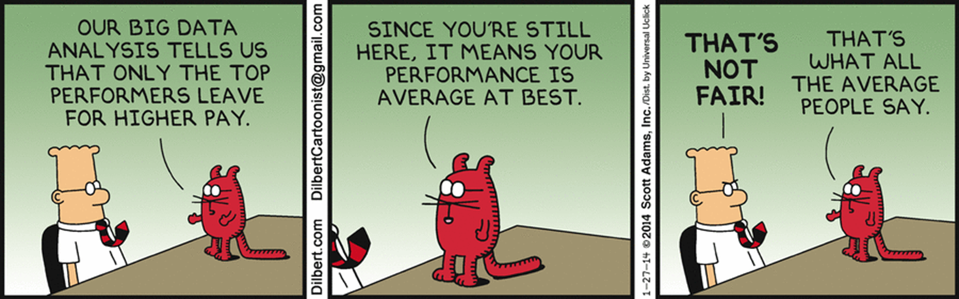
Agenda
01 Company Overview
02 Employee Overview
03 HMO or PPO

Slide 3
01
Laserfiche
THE COMPANY
Notes:
Say: Laserfiche has taken the time to implement well-developed policies and procedures, which outline behavior and performance standards. This gives managers and team members a better understanding of overall expectations.

Slide 4
Who is Laserfiche?
Laserfiche is a leading provider of
content management and business process automation software.
We help companies digitally transform their business processes with our easy-to-use but customizable software.

Slide 5

Nien-Ling Wacker
“At Laserfiche, we make software people love to use.”
1944 - 2014

Slide 6
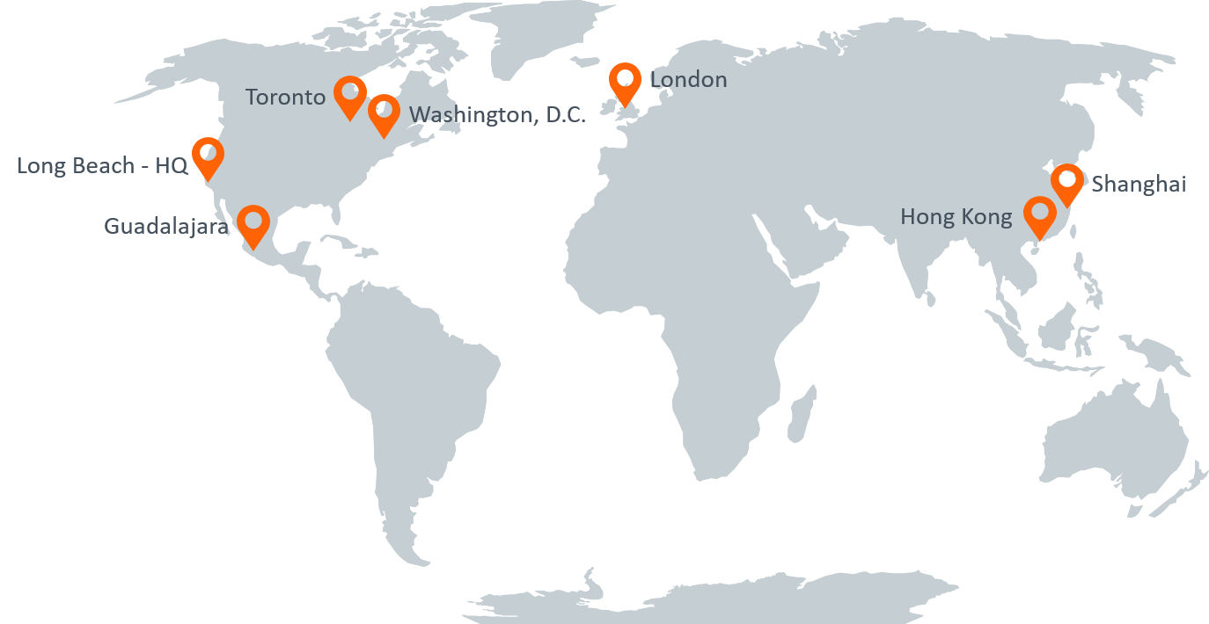
Company Profile
1987
FOUNDED
400+
EMPLOYEES
36,000
INSTALLATIONS
7
OFFICE LOCATIONS
5
MILLION END USERS in 80 COUNTRIES
Notes:
Ask: When you applied here, had any of you heard about Laserfiche and its products?
Expected Responses: May Vary.
Say: About every 6-weeks we offer a 3-day new hire orientation course. You will be invited to join us to learn more about our company history and products. Today we’re going to provide you a high level overview. As I mentioned earlier, Laserfiche was founded in 1987. We’ve grown substantially since then, and now have 7 offices worldwide – here in Long Beach, Washington D.C., Toronto, Guadalajara, the U.K., Shanghai, and Hong Kong.
Say: To date, we have a little over 400 employees world wide, of which 299 ☺ are located at our Long Beach headquarters. Throughout the years we’ve had over 36,000 unique installations of the software worldwide, which accounts for over 5 million end users.
Laserfiche is a privately held company that has been in business for over 30 years. We have over 450 employees across 7 offices. The vast majority (320) of our employees work here in Long Beach, out of our corporate headquarters.
Laserfiche is the leading global provider of intelligent content management and business process automation. The Laserfiche® platform enables organizations in more than 80 countries to transform into digital businesses. Customers in every industry—including government, education, financial services and manufacturing—use Laserfiche® to boost productivity, scale their business and deliver digital-first customer experiences.
Laserfiche employees in offices around the world are committed to the company’s vision of empowering customers and inspiring people to reimagine how technology can transform lives.
This map depicts our customer concentration worldwide…

Slide 7






Laserfiche Product Suites
Digitize
Scan and capture
Repository
Quick Fields
Automate
Forms
Business Process
Transform
Robotic Process Automation (Bots)
Connector
Software Development Kit (SDK)

Slide 8
02
Laserfiche
ITS EMPLOYEES
Notes:
Say: Laserfiche has taken the time to implement well-developed policies and procedures, which outline behavior and performance standards. This gives managers and team members a better understanding of overall expectations.

Slide 9
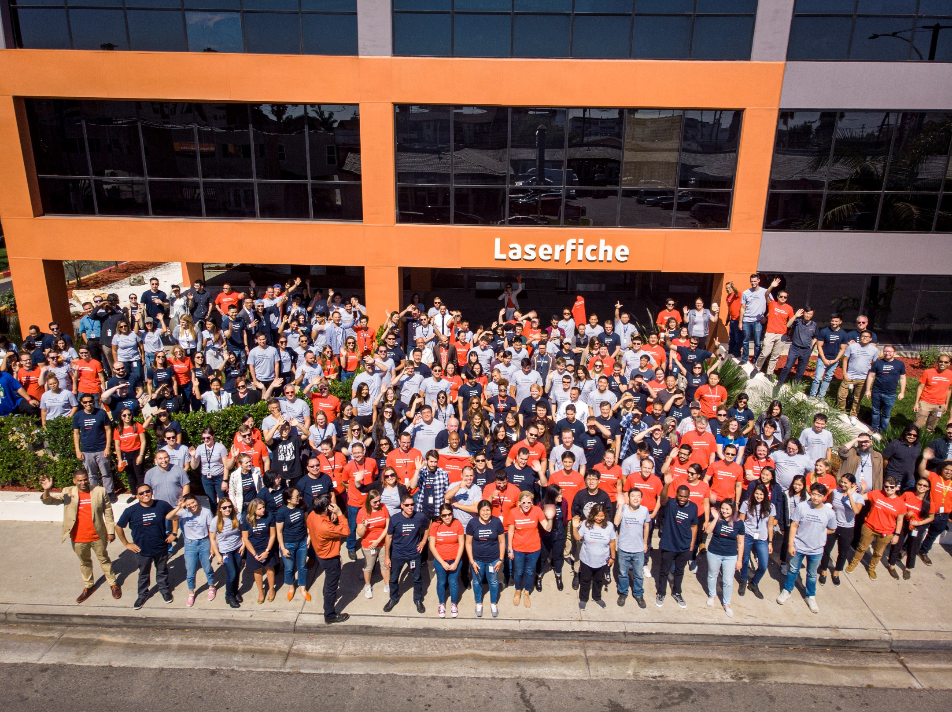

Slide 10
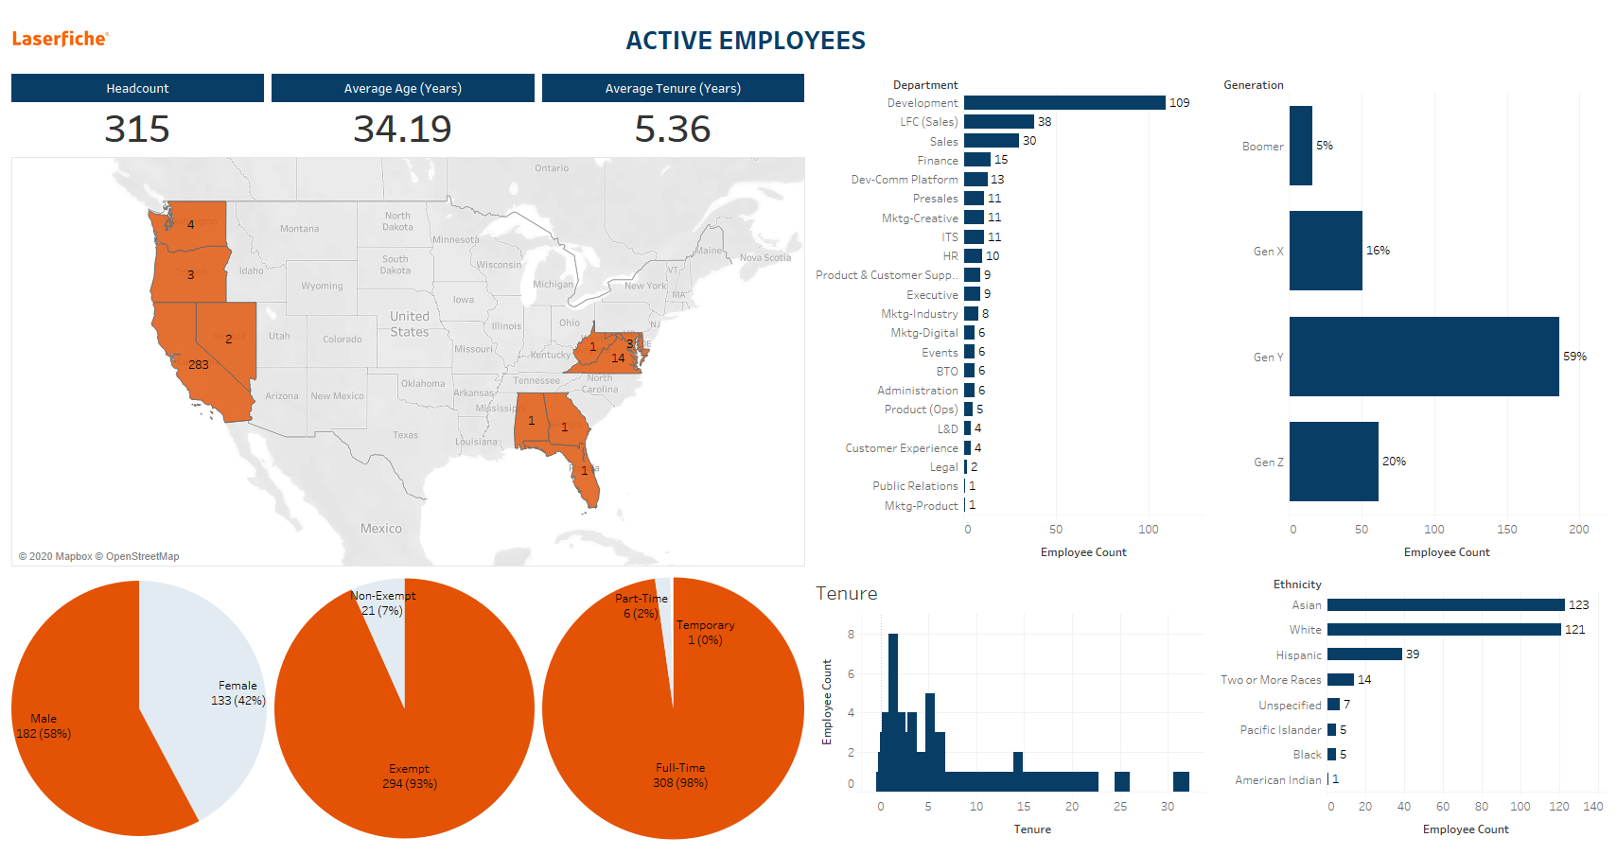

Slide 11
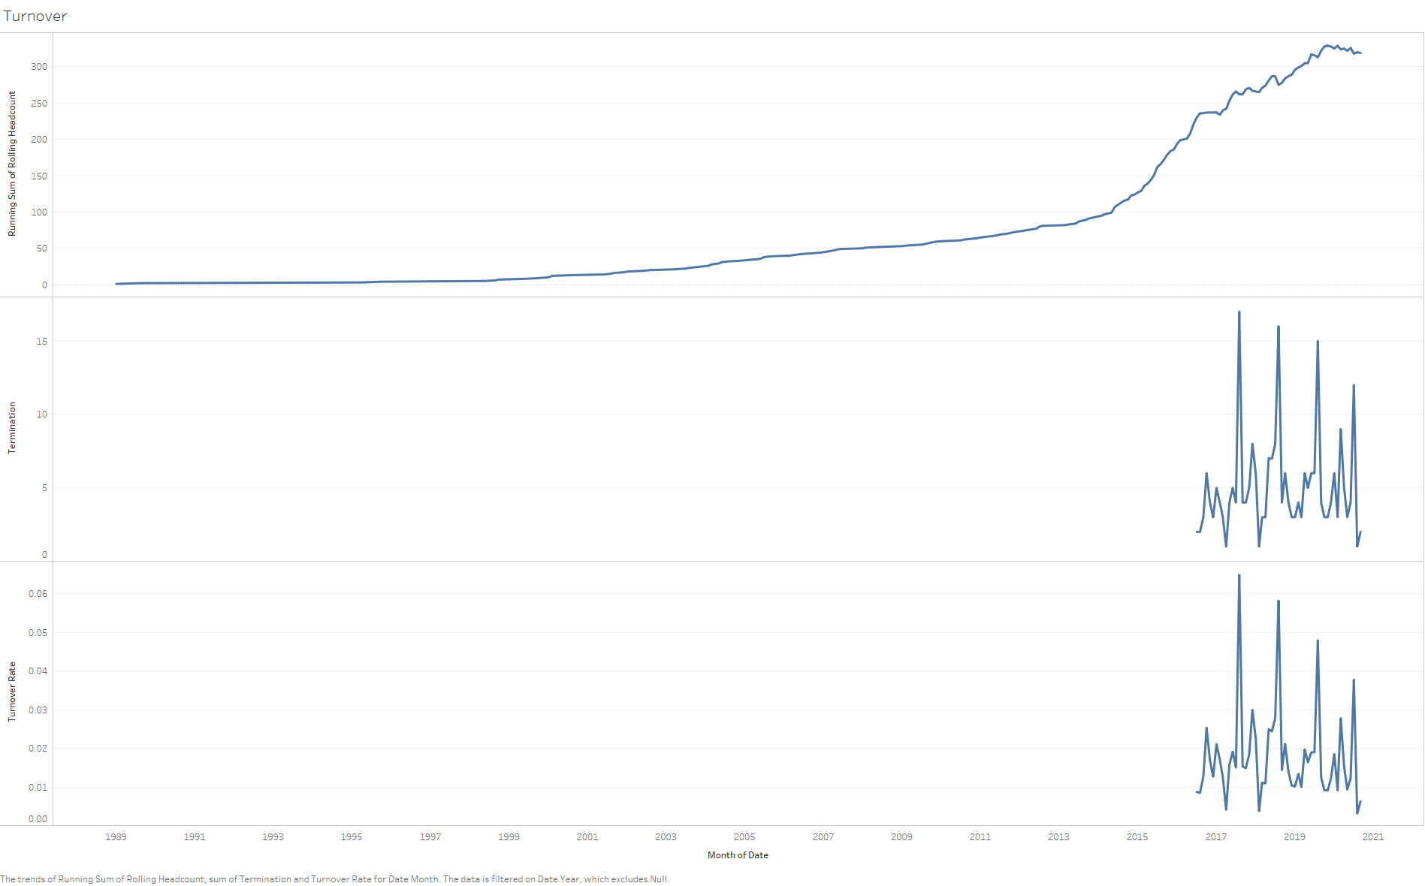

Slide 12
03
HMO or PPO
Notes:
Say: Laserfiche has taken the time to implement well-developed policies and procedures, which outline behavior and performance standards. This gives managers and team members a better understanding of overall expectations.

Slide 13
HMO or PPO: What is it?
Health Maintenance Organization (HMO)
Preferred Provider Organization (PPO)
These are two of many types of medical plan models

Slide 14
HMO or PPO: What’s the difference anyway?
Gatekeeper
Deductible
Copay/Coinsurance
Provider flexibility

Slide 15
Which plan will employees choose?
Given an employees features, predict whether an employee will choose an HMO or PPO
Features:
Age
Gender
Ethnicity
Department
State lived-in
Salary range

Slide 16
Accuracy Score per Model?

Slide 17
Which features were important?
State you live
Age
Gender
Ethnicity
Department
State lived-in
Salary range

Slide 18
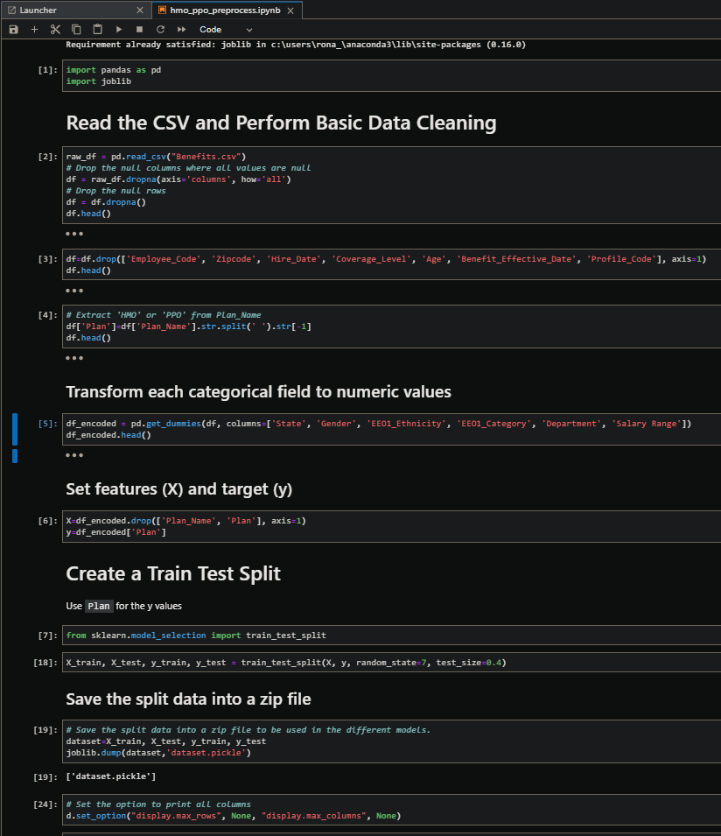
Preprocess Data

Slide 19
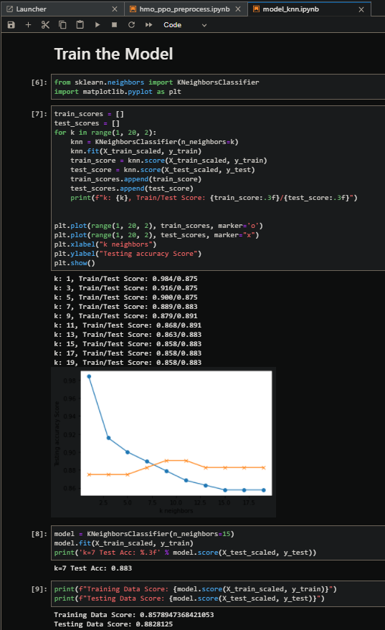
KNeighbors

Slide 20
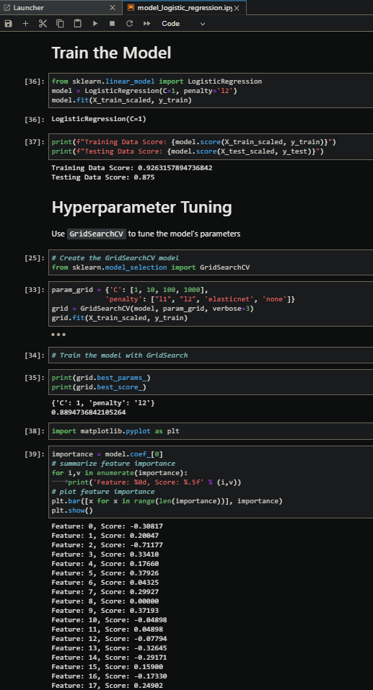
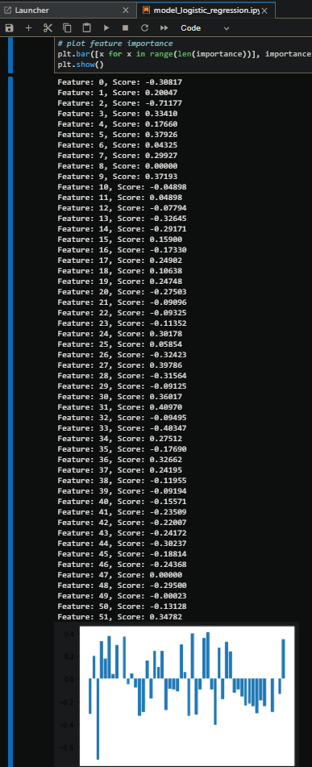
Logistic Regression

Slide 21
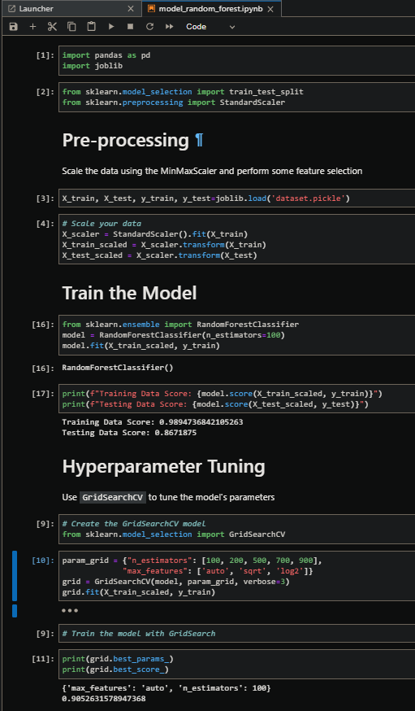
Random Forest

Slide 22
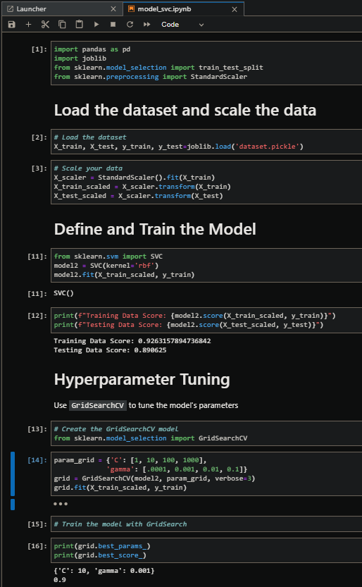
Support Vector Classifier

Slide 23
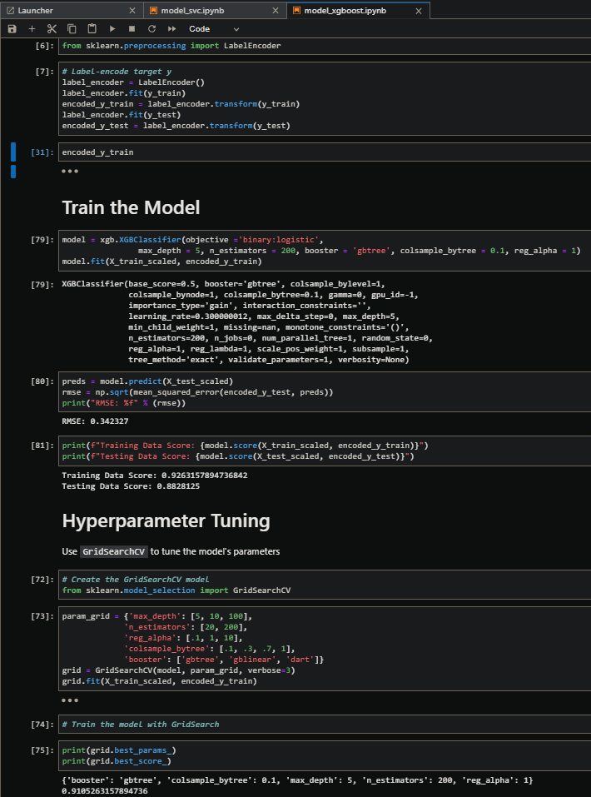
XGBoost Classifier

Slide 24
Let’s go out there and rock the data world!

